Slide 1
How to use this deck
First, make a copy of this deck to create your presentation.
To customize the deck to your needs, pick the slides you want to keep and delete everything else.
You can right-click in the left-hand window to create a brand new slide—or just duplicate an existing slide and delete its content.
Handy tips
Export to PPT by clicking File > Download > Microsoft PowerPoint.
When you paste text, paste without formatting; the pasted text will adopt the correct font and size.
If you need to reduce the size of body copy to fit, consider splitting your slide over two pages.
You can increase the size of text to highlight key points.
Layout rules
Do not change the size or placement of the titles.
Use the light or thin weights of fonts for most text and the bold just for highlights.
Place large images on their own slides, or on angle-framed master pages. To add the image to these, right-click and set the image as the background. Remember to use images with a resolution of at least 1920 x 1080 (16:9 ratio).
Avoid placing text over images

Slide 2
Project Murdock
Andrew Tan - Arizona State University – 10/16/2025
Project Title

Slide 3
Project Murdock
Log Line
The core concept is about exploring what it would be like to be blind, using the Marvel character Daredevil.
Project Title
Notes:
What is the core concept? What’s the big Idea? What are the trailer moments
When [INCITING INCIDENT OCCURS]...
A [CHARACTER TYPE]...Must [OBJECTIVE]...
Before [STAKES].
Examples:
Good Will Hunting - A young janitor at M.I.T. has a gift for mathematics but needs help from a psychologist to find direction in his life.
Toy Story - Examples:
Good Will Hunting - A young janitor at M.I.T. has a gift for mathematics but needs help from a psychologist to find direction in his life.
Toy Story - A cowboy doll is profoundly threatened and jealous when a new spaceman figure supplants him as top toy in a boy's room.doll is profoundly threatened and jealous when a new spaceman figure supplants him as top toy in a boy's room.

Slide 4
Synopsis
Project Murdock is a narrative-driven, VR experience that follows the life story of Marvel character “Daredevil”, as he learns to navigate the world using his newfound heightened senses and abilities.
The project would follow Matt Murdock’s life, as he learns to navigate his new world after the accident that blinded him. This would involve the player first exploring the world, with no training or guidance for how to “see”. He would eventually meet his master, “Sticks”, who trains him to hone is other senses to perceive the world in a new way. The project would end by having the player become “Daredevil”.
Notes:
Provide a brief summary of your story’s core concept.

Slide 5
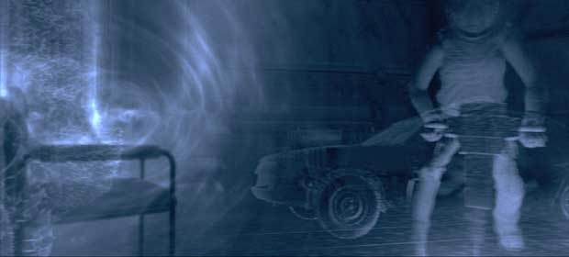
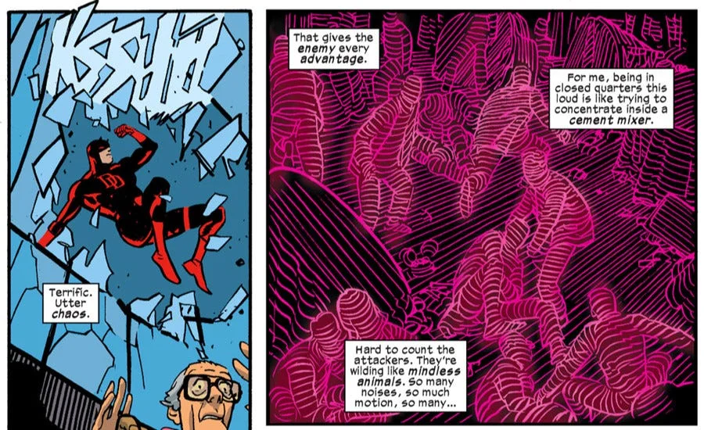
Inspired by
Idea for execution?
Project Title

Slide 6
What is authentic about my XR project
Project Title
Notes:
Provide a brief description on how your film is something you connect with

Slide 7
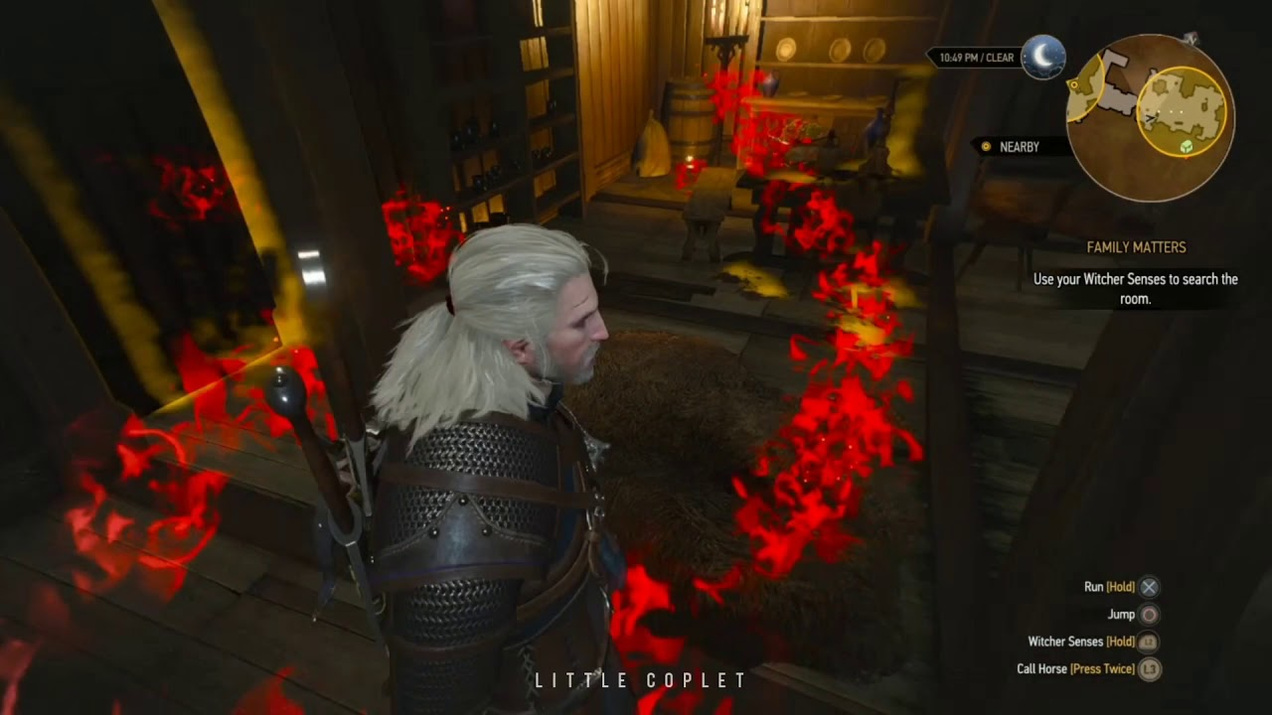
XR interaction
Murdock would be able to see his own body, but not his environment:
This also includes anything that he comes into contact with, albeit in a more blurry resolution
Murdock’s unique trait is his heightened senses, the focus for this project being:
Hearing - Visualized doppler effect, with sound being enhanced
Touch - Hands and body will physically collide with world
Smell - Access a “smell” world, where you can “see” smells
Notes:
Provide a list or description of the visual effects you are planning on using (optional)

Slide 8
Genre of the project
Action, Fantasy
Project Title
Notes:
Provide a brief description of which genre best fits your film. Feel free to populate it with some image examples.

Slide 9
Tone of the project
Notes:
Provide a brief description of the mood or atmosphere of your film.

Slide 10
Color tones/themes
Notes:
Provide some image references for the tone

Slide 11
Music style references
Notes:
Provide a list of musical references that best fit your film.

Slide 12
Sound design
Notes:
Provide a list of different sound designs that might best fit your film.

Slide 13
Dialogue/voice over?

Slide 14
Storyboards - Concept Design - Levels
Notes:
Provide a link or images to your storyboard or previz frames

Slide 15
Characters?
Notes:
Provide a brief description of your character (age, personality traits, physical appearance) and pick some good reference images

Slide 16
Environments
Notes:
Provide a brief description of there your film will take place. One location or multiple locations, indoor or outdoors?

Slide 17
Other references
Notes:
This could be any anything you are inspired by

Slide 18
Thank You!
Name – Date - Version
Please share your images and videos
Delete this note

